Slide 1
Basics of Markov chain simulation
林思涵
2021/01/05

Slide 2
Chapter 11
11.1 Gibbs sampler
11.2 Metropolis and Metropolis-Hastings algorithms
11.3 Using Gibbs and Metropolis as building blocks
11.4 Inference and assessing convergence
11.5 Effective number of simulation draws
11.6 Example: hierarchical normal model

Slide 3
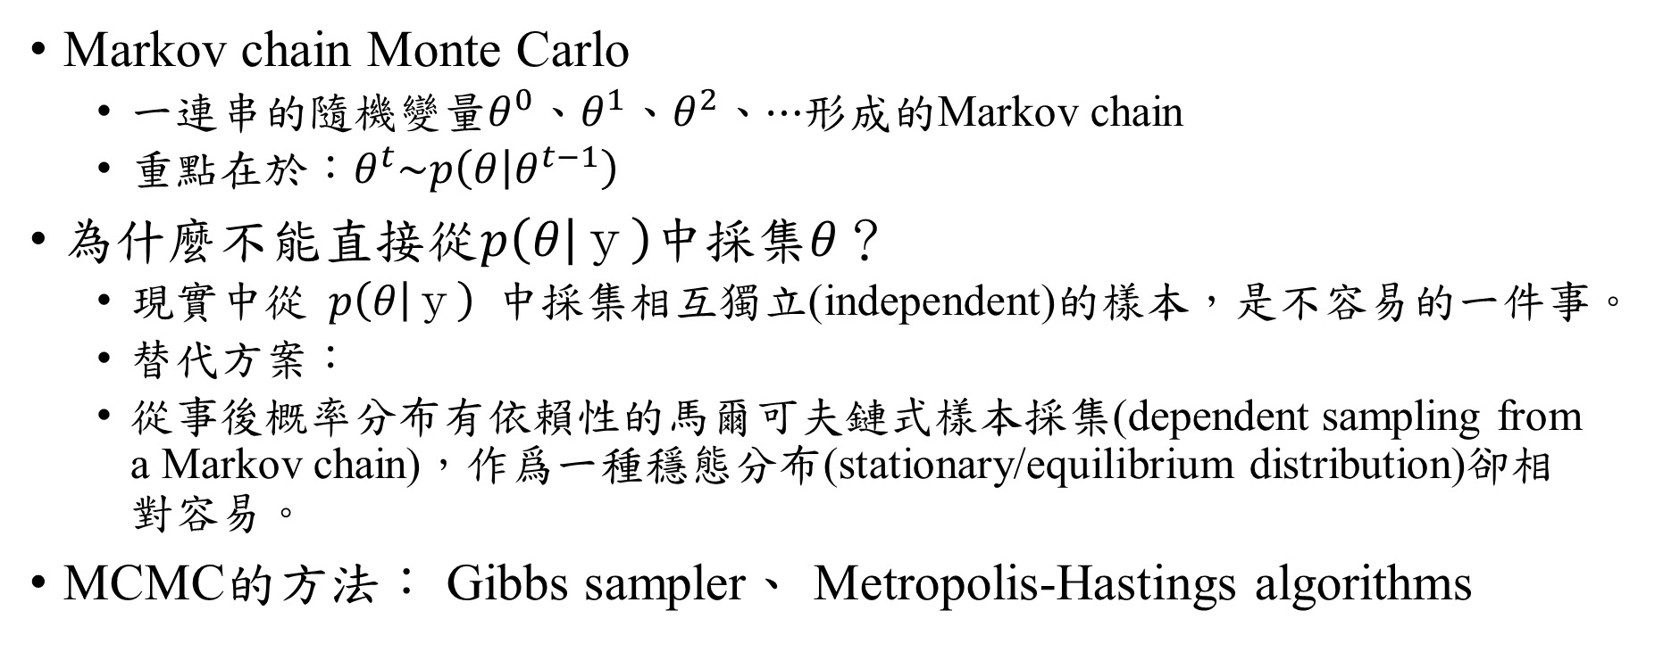
MCMC
Markov chain Monte Carlo
一連串的隨機變量$θ^{0}$、$θ^{1}$、$θ^{2}$、$⋯$形成的Markov chain
重點在於：$θ^{t}\sim p\left(θ | θ^{t−1}\right)$
為什麼不能直接從$p\left(θ | ｙ\right)$中採集$θ$？
現實中從$p\left(θ | ｙ\right)$中採集相互獨立(independent)的樣本，是不容易的一件事。
替代方案：
從事後概率分布有依賴性的馬爾可夫鏈式樣本採集(dependent sampling from a Markov chain)，作爲一種穩態分布(stationary/equilibrium distribution)卻相對容易。
MCMC的方法： Gibbs sampler、 Metropolis-Hastings algorithms

Slide 4

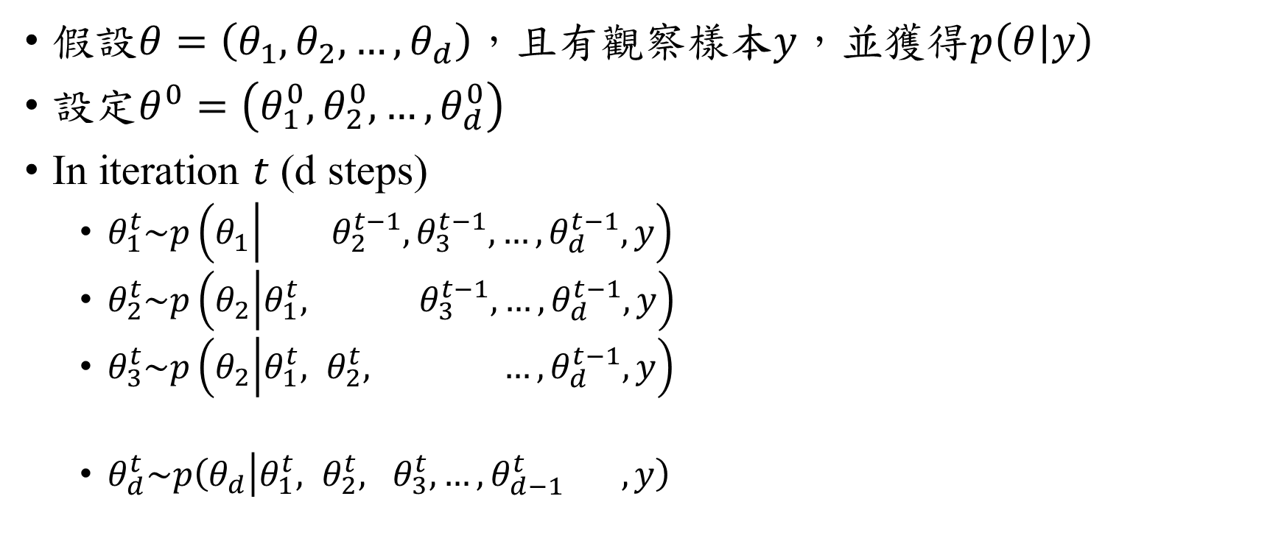

Gibbs sampler
假設$θ=\left(θ_{1}, θ_{2}, …, θ_{d}\right)$，且有觀察樣本$y$，並獲得$p\left(θ|y\right)$
設定$θ^{0}=\left(θ_{1}^{0},θ_{2}^{0},…,θ_{d}^{0}\right)$
In iteration $t$ (d steps)
$θ_{1}^{t}\sim p\left(θ_{1} | {}_{}^{} θ_{2}^{t−1},θ_{3}^{t−1},…,θ_{d}^{t−1},y\right)$
$θ_{2}^{t}\sim p\left(θ_{2} | θ_{1}^{t}, {}_{}^{} θ_{3}^{t−1},…,θ_{d}^{t−1},y\right)$
$θ_{3}^{t}\sim p\left(θ_{2} | θ_{1}^{t}, θ_{2}^{t}, {}_{}^{} …,θ_{d}^{t−1},y\right)$
$θ_{d}^{t}\sim p\left(θ_{d} | θ_{1}^{t}, θ_{2}^{t}, θ_{3}^{t},…,θ_{d−1}^{t} ,y\right)$
$$θ_{j}^{t}\sim p\left(θ_{j}|θ_{−j}^{t−1},y\right)$$
$$θ_{−j}^{t−1}=\left(θ_{1}^{t},…,θ_{j−1}^{t},θ_{j+1}^{t−1},…,θ_{d}^{t−1}\right)$$

Slide 5

Gibbs sampler ~ Example ~
$θ=\left(θ_{1}, θ_{2}\right)$
A single observation $y=\left(y_{1},y_{2}\right)=\left(0,0\right)$
$θ|y\sim N\left(\left(\begin{matrix}y_{1} \\ y_{2}\end{matrix}\right),\left(\begin{matrix}1 & ρ \\ ρ & 1\end{matrix}\right)\right)$, $ρ=0.8$
利用Gibbs sampler生成$θ=\left(θ_{1}, θ_{2}\right)$

Slide 6
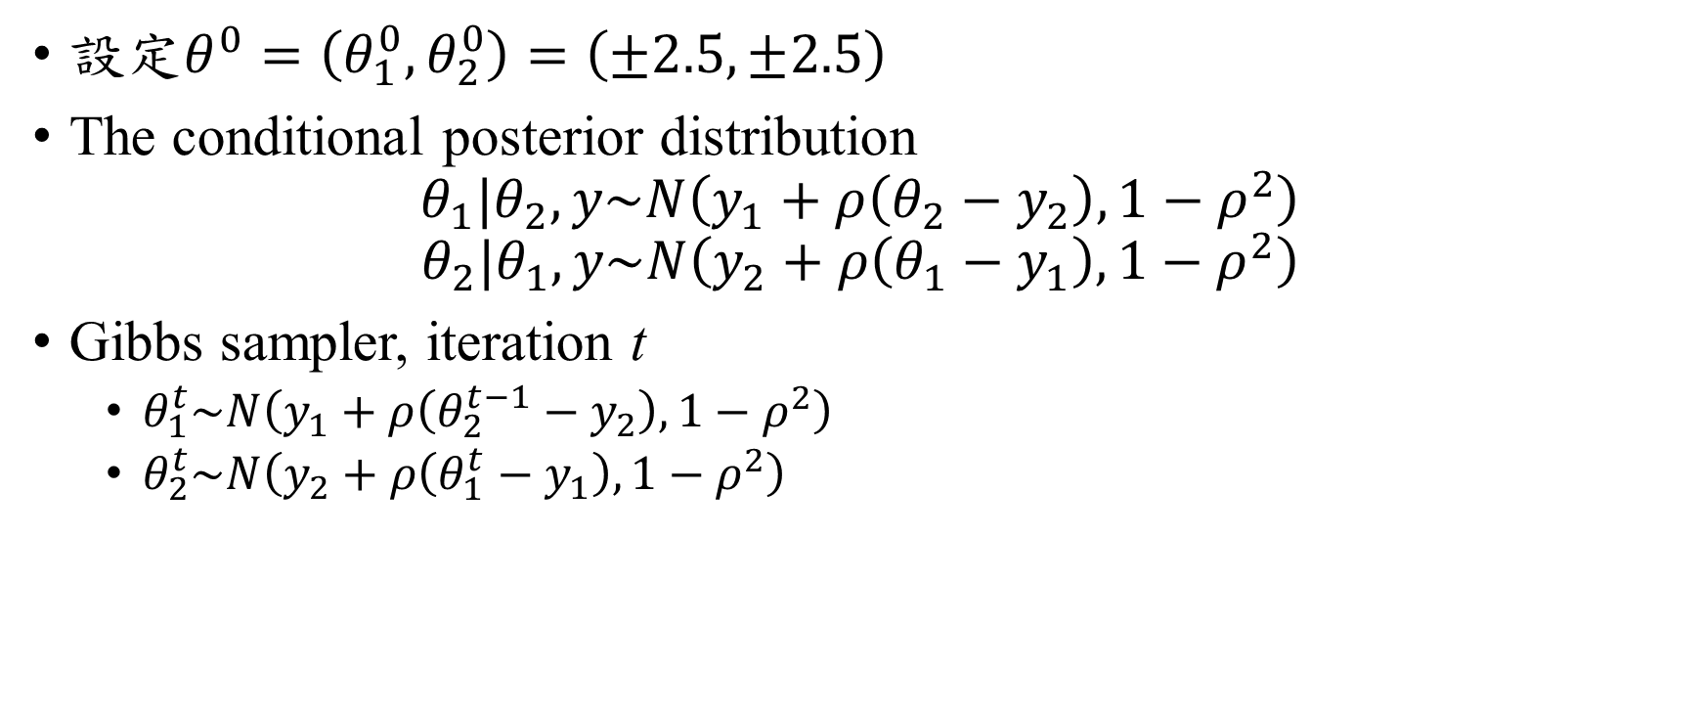
Gibbs sampler ~ Example ~
設定$θ^{0}=\left(θ_{1}^{0},θ_{2}^{0}\right)=\left(±2.5, ±2.5\right)$
The conditional posterior distribution
$$θ_{1}|θ_{2},y\sim N\left(y_{1}+ρ\left(θ_{2}−y_{2}\right),1−ρ^{2}\right)$$
$$θ_{2}|θ_{1},y\sim N\left(y_{2}+ρ\left(θ_{1}−y_{1}\right),1−ρ^{2}\right)$$
Gibbs sampler, iteration t
$θ_{1}^{t}\sim N\left(y_{1}+ρ\left(θ_{2}^{t−1}−y_{2}\right),1−ρ^{2}\right)$
$θ_{2}^{t}\sim N\left(y_{2}+ρ\left(θ_{1}^{t}−y_{1}\right),1−ρ^{2}\right)$

Slide 7
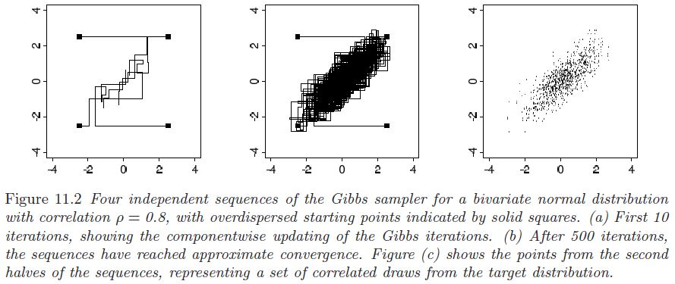
Gibbs sampler ~ Example ~

Slide 8
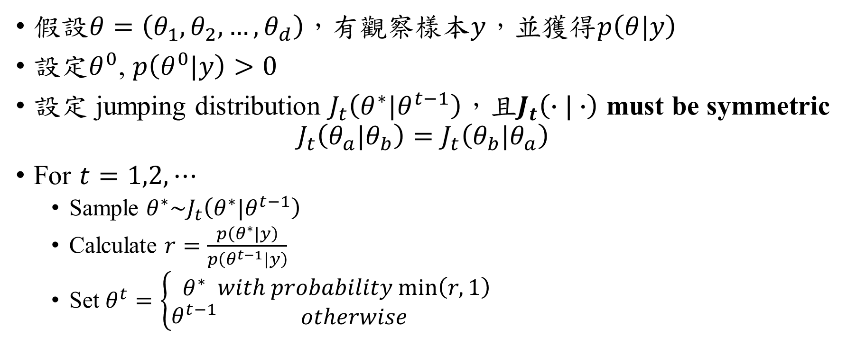
Metropolis Algorithm
假設$θ=\left(θ_{1}, θ_{2}, …, θ_{d}\right)$，有觀察樣本$y$，並獲得$p\left(θ|y\right)$
設定$θ^{0}$, $p\left(θ^{0}|y\right)>0$
設定 jumping distribution $J_{t}\left(θ^{∗}|θ^{t−1}\right)$，且$J_{t}\left(∙|∙\right)$ must be symmetric
$$J_{t}\left(θ_{a}|θ_{b}\right)=J_{t}\left(θ_{b}|θ_{a}\right)$$
For $t=1,2,⋯$
Sample $θ^{∗}\sim J_{t}\left(θ^{∗}|θ^{t−1}\right)$
Calculate $r=\frac{p\left(θ^{∗}|y\right)}{p\left(θ^{t−1}|y\right)}$
Set $θ^{t}=\left\{\begin{matrix}θ^{∗} \\ θ^{t−1}\end{matrix}\begin{matrix}with probability min\left(r,1\right) \\ otherwise\end{matrix}\right.$

Slide 9

Metropolis Algorithm ~ Example ~
$θ=\left(θ_{1}, θ_{2}\right)$
A single observation $y=\left(y_{1},y_{2}\right)=\left(0,0\right)$
$θ|y\sim N\left(y,I\right)$
利用Metropolis Algorithm生成$θ=\left(θ_{1}, θ_{2}\right)$

Slide 10
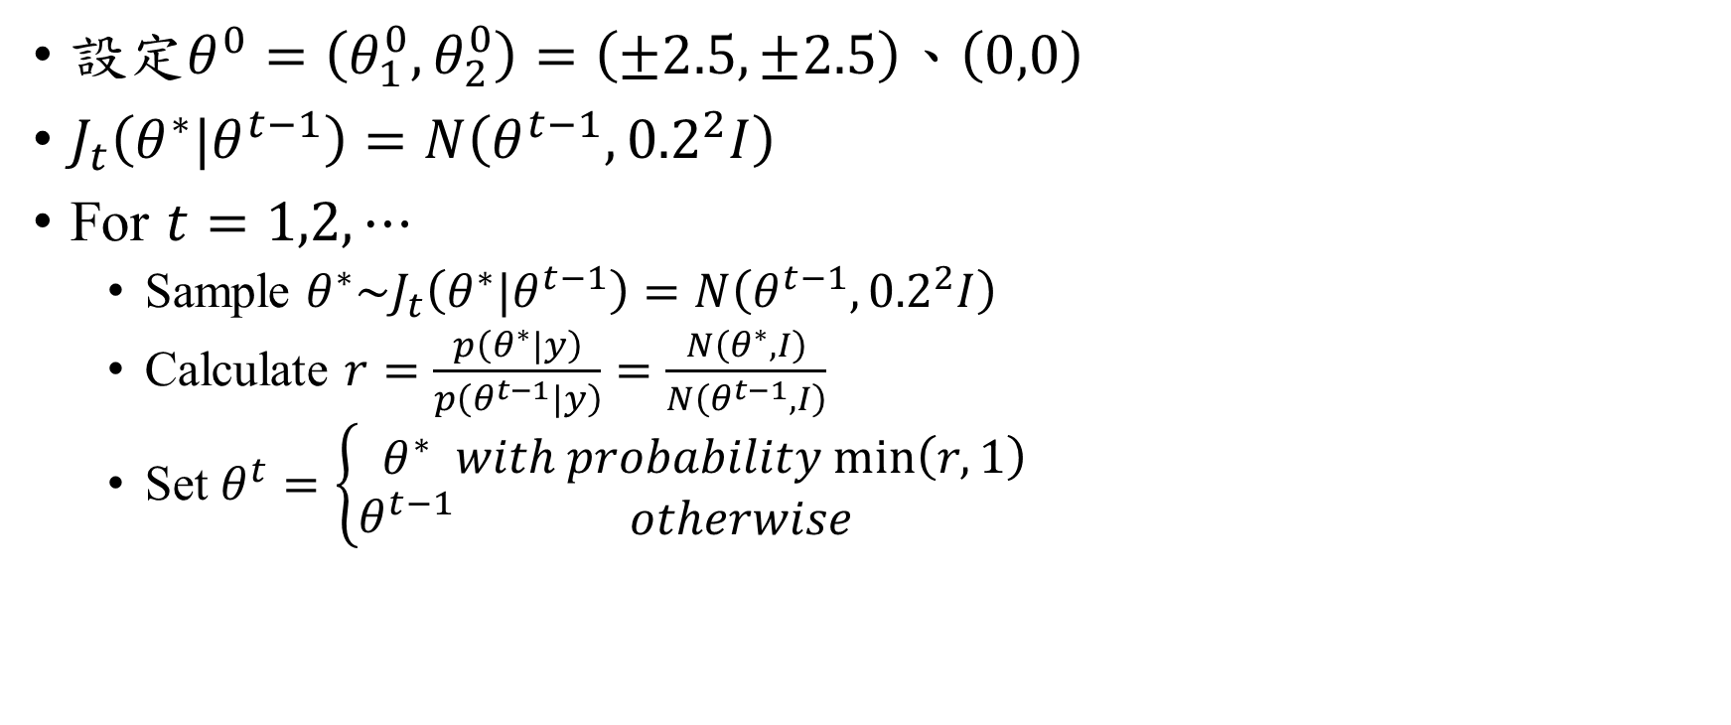
Metropolis Algorithm ~ Example ~
設定$θ^{0}=\left(θ_{1}^{0},θ_{2}^{0}\right)=\left(±2.5, ±2.5\right)$、$\left(0,0\right)$
$J_{t}\left(θ^{∗}|θ^{t−1}\right)=N\left(θ^{t−1},{0.2}^{2}I\right)$
For $t=1,2,⋯$
Sample $θ^{∗}\sim J_{t}\left(θ^{∗}|θ^{t−1}\right)=N\left(θ^{t−1},{0.2}^{2}I\right)$
Calculate $r=\frac{p\left(θ^{∗}|y\right)}{p\left(θ^{t−1}|y\right)}=\frac{N\left(θ^{∗}, I\right)}{N\left(θ^{t−1}, I\right)}$
Set $θ^{t}=\left\{\begin{matrix}θ^{∗} \\ θ^{t−1}\end{matrix}\begin{matrix}with probability min\left(r,1\right) \\ otherwise\end{matrix}\right.$

Slide 11
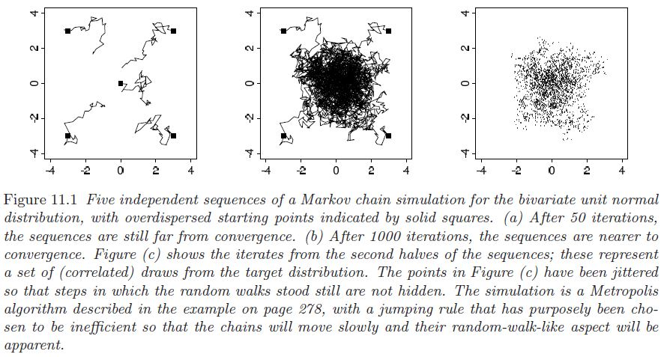
Metropolis Algorithm ~ Example ~

Slide 12
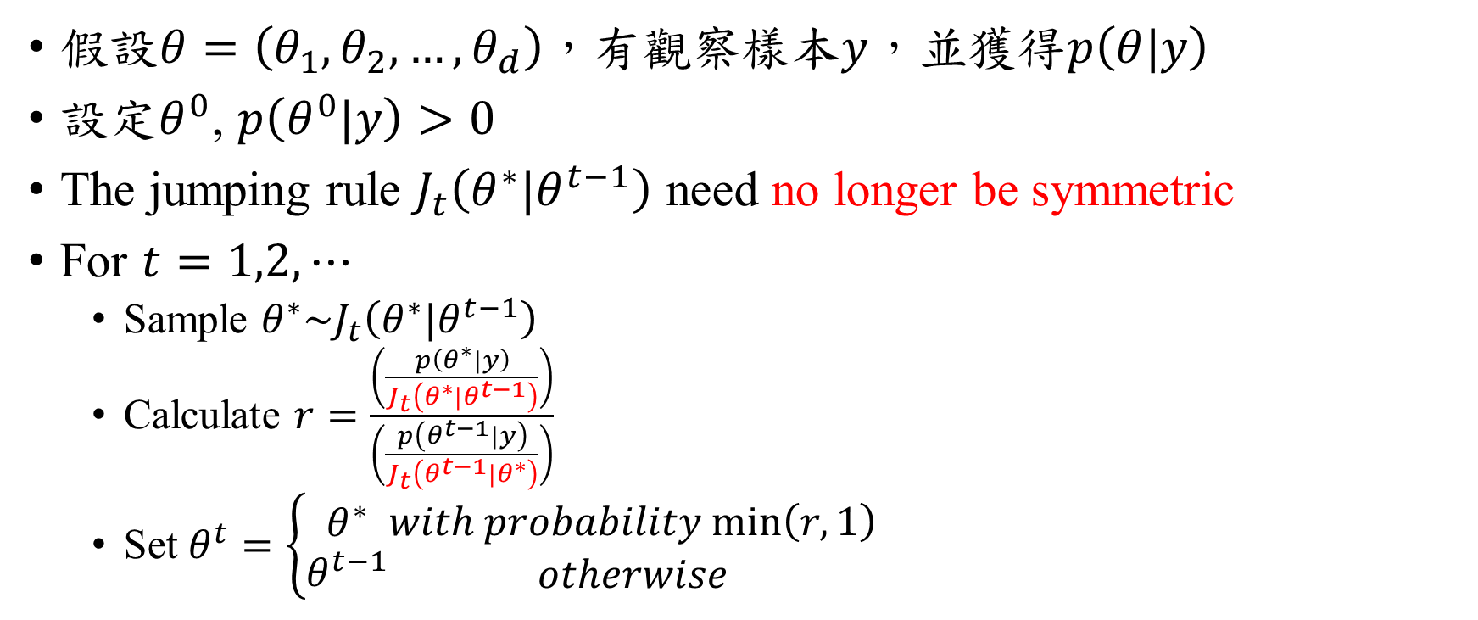
Metropolis-Hastings Algorithms
假設$θ=\left(θ_{1}, θ_{2}, …, θ_{d}\right)$，有觀察樣本$y$，並獲得$p\left(θ|y\right)$
設定$θ^{0}$, $p\left(θ^{0}|y\right)>0$
The jumping rule $J_{t}\left(θ^{∗}|θ^{t−1}\right)$ need no longer be symmetric
For $t=1,2,⋯$
Sample $θ^{∗}\sim J_{t}\left(θ^{∗}|θ^{t−1}\right)$
Calculate $r=\frac{\left(\frac{p\left(θ^{∗}|y\right)}{J_{t}\left(θ^{∗}|θ^{t−1}\right)}\right)}{\left(\frac{p\left(θ^{t−1}|y\right)}{J_{t}\left(θ^{t−1}|θ^{∗}\right)}\right)}$
Set $θ^{t}=\left\{\begin{matrix}θ^{∗} \\ θ^{t−1}\end{matrix}\begin{matrix}with probability min\left(r,1\right) \\ otherwise\end{matrix}\right.$

Slide 13
Gibbs sampler 和 Metropolis Algorithm
都是Metropolis-Hastings Algorithm 的特例!!!

Slide 14
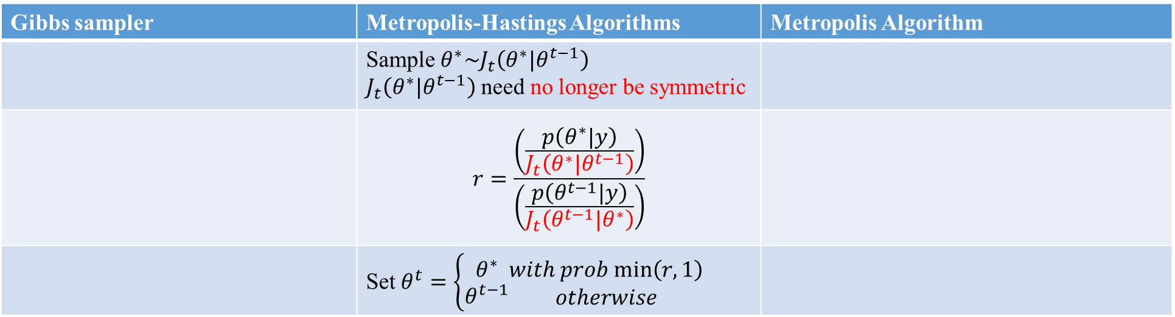
Gibbs sampler | Metropolis-Hastings Algorithms | Metropolis Algorithm
 | Sample $θ^{∗}\sim J_{t}\left(θ^{∗}|θ^{t−1}\right)$ $J_{t}\left(θ^{∗}|θ^{t−1}\right)$ need no longer be symmetric
 | $$r=\frac{\left(\frac{p\left(θ^{∗}|y\right)}{J_{t}\left(θ^{∗}|θ^{t−1}\right)}\right)}{\left(\frac{p\left(θ^{t−1}|y\right)}{J_{t}\left(θ^{t−1}|θ^{∗}\right)}\right)}$$
 | Set $θ^{t}=\left\{\begin{matrix}θ^{∗} \\ θ^{t−1}\end{matrix}\begin{matrix}with prob min\left(r,1\right) \\ otherwise\end{matrix}\right.$

Slide 15
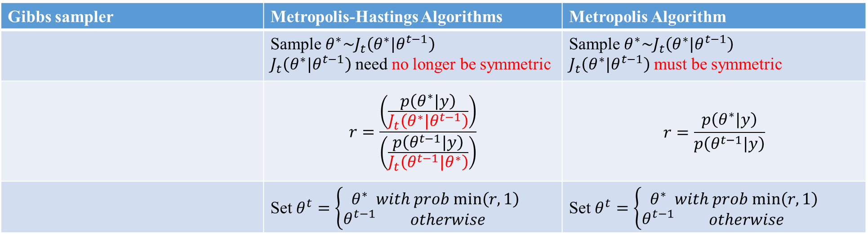
Gibbs sampler | Metropolis-Hastings Algorithms | Metropolis Algorithm
 | Sample $θ^{∗}\sim J_{t}\left(θ^{∗}|θ^{t−1}\right)$ $J_{t}\left(θ^{∗}|θ^{t−1}\right)$ need no longer be symmetric | Sample $θ^{∗}\sim J_{t}\left(θ^{∗}|θ^{t−1}\right)$ $J_{t}\left(θ^{∗}|θ^{t−1}\right)$ must be symmetric
 | $$r=\frac{\left(\frac{p\left(θ^{∗}|y\right)}{J_{t}\left(θ^{∗}|θ^{t−1}\right)}\right)}{\left(\frac{p\left(θ^{t−1}|y\right)}{J_{t}\left(θ^{t−1}|θ^{∗}\right)}\right)}$$ | $$r=\frac{p\left(θ^{∗}|y\right)}{p\left(θ^{t−1}|y\right)}$$
 | Set $θ^{t}=\left\{\begin{matrix}θ^{∗} \\ θ^{t−1}\end{matrix}\begin{matrix}with prob min\left(r,1\right) \\ otherwise\end{matrix}\right.$ | Set $θ^{t}=\left\{\begin{matrix}θ^{∗} \\ θ^{t−1}\end{matrix}\begin{matrix}with prob min\left(r,1\right) \\ otherwise\end{matrix}\right.$

Slide 16
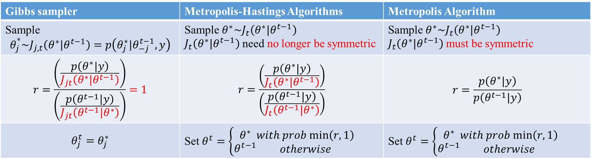
Gibbs sampler | Metropolis-Hastings Algorithms | Metropolis Algorithm
Sample $$θ_{j}^{*}\sim J_{j,t}\left(θ^{∗}|θ^{t−1}\right)=p\left(θ_{j}^{∗}|θ_{−j}^{t−1},y\right)$$ | Sample $θ^{∗}\sim J_{t}\left(θ^{∗}|θ^{t−1}\right)$ $J_{t}\left(θ^{∗}|θ^{t−1}\right)$ need no longer be symmetric | Sample $θ^{∗}\sim J_{t}\left(θ^{∗}|θ^{t−1}\right)$ $J_{t}\left(θ^{∗}|θ^{t−1}\right)$ must be symmetric
$$r=\frac{\left(\frac{p\left(θ^{∗}|y\right)}{J_{jt}\left(θ^{∗}|θ^{t−1}\right)}\right)}{\left(\frac{p\left(θ^{t−1}|y\right)}{J_{jt}\left(θ^{t−1}|θ^{∗}\right)}\right)}=1$$ | $$r=\frac{\left(\frac{p\left(θ^{∗}|y\right)}{J_{t}\left(θ^{∗}|θ^{t−1}\right)}\right)}{\left(\frac{p\left(θ^{t−1}|y\right)}{J_{t}\left(θ^{t−1}|θ^{∗}\right)}\right)}$$ | $$r=\frac{p\left(θ^{∗}|y\right)}{p\left(θ^{t−1}|y\right)}$$
$$θ_{j}^{t}=θ_{j}^{∗}$$ | Set $θ^{t}=\left\{\begin{matrix}θ^{∗} \\ θ^{t−1}\end{matrix}\begin{matrix}with prob min\left(r,1\right) \\ otherwise\end{matrix}\right.$ | Set $θ^{t}=\left\{\begin{matrix}θ^{∗} \\ θ^{t−1}\end{matrix}\begin{matrix}with prob min\left(r,1\right) \\ otherwise\end{matrix}\right.$

Slide 17
Why does the Metropolis algorithm work?
The simulated sequence is a Markov chain with a unique stationary distribution.
The stationary distribution equals this target distribution.

Slide 18
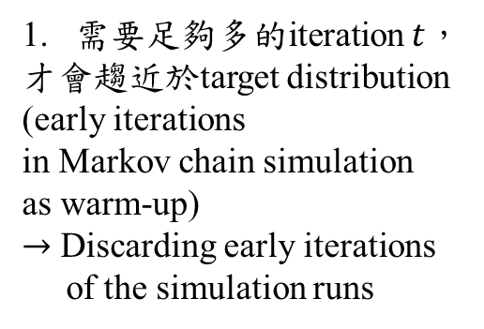
MCMC
10
500
需要足夠多的iteration $t$，
才會趨近於target distribution
(early iterations
in Markov chain simulation
as warm-up)
$→$ Discarding early iterations
of the simulation runs
2. Dependence of the iterations
in each sequence
3. Multiple sequences
with overdispersed starting points
50
1000

Slide 19
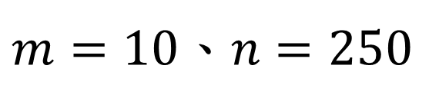
Assessing Convergence
Let m be the number of chains and n be the length of each chain.
Example:
1000 iterations
1
2
5
4
3
5 chains, each of length 1000
Step 1、 Discard the first half of each as warm-up
5 chains, each of length 500
Step 2、Split each into two parts
10 chains, each of length 250
$m=10$、$n=250$

Slide 20
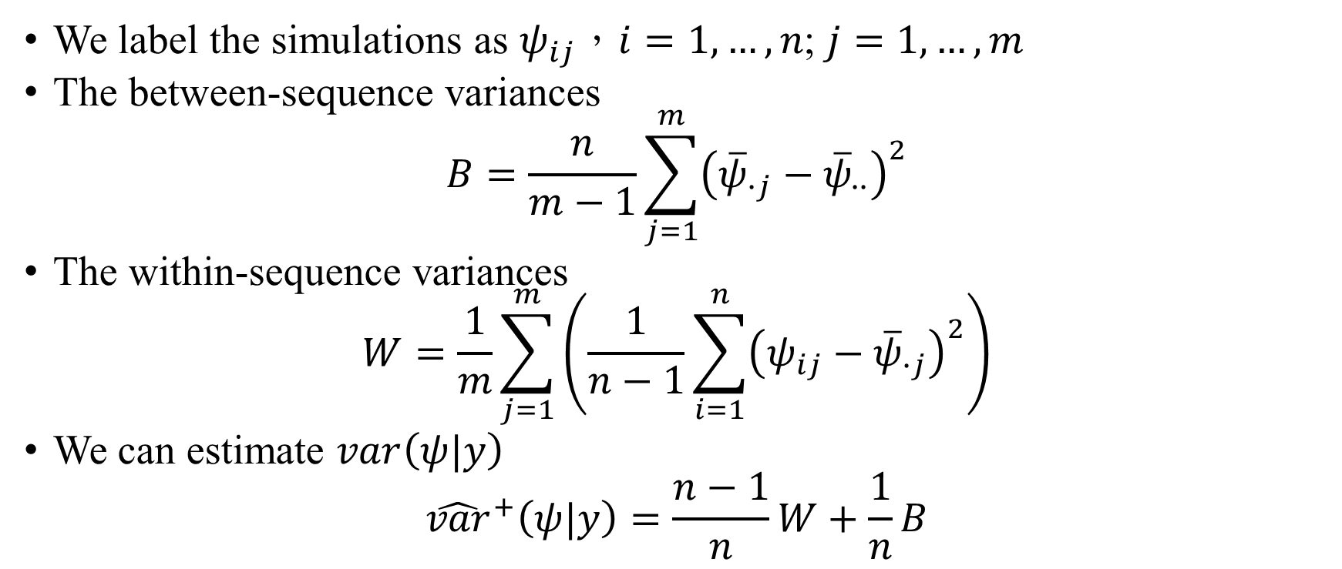
Assessing Convergence
We label the simulations as $ψ_{ij}$，$i=1,…,n$; $j=1,…,m$
The between-sequence variances
$$B=\frac{n}{m−1}\sum_{j=1}^{m}{{\left({\overline{ψ}}_{∙j}−{\overline{ψ}}_{∙∙}\right)}^{2}}$$
The within-sequence variances
$$W=\frac{1}{m}\sum_{j=1}^{m}{\left(\frac{1}{n−1}\sum_{i=1}^{n}{{\left(ψ_{ij}−{\overline{ψ}}_{∙j}\right)}^{2}}\right)}$$
We can estimate $var\left(ψ|y\right)$
$${\hat{var}}^{+}\left(ψ|y\right)=\frac{n−1}{n}W+\frac{1}{n}B$$

Slide 21

Assessing Convergence
In the limit as $n→∞$, the expectation of W approaches $var\left(ψ|y\right)$
The potential scale reduction is estimated by
$$\hat{R}=\sqrt{\frac{{\hat{var}}^{+}\left(ψ|y\right)}{W}}$$

Slide 22
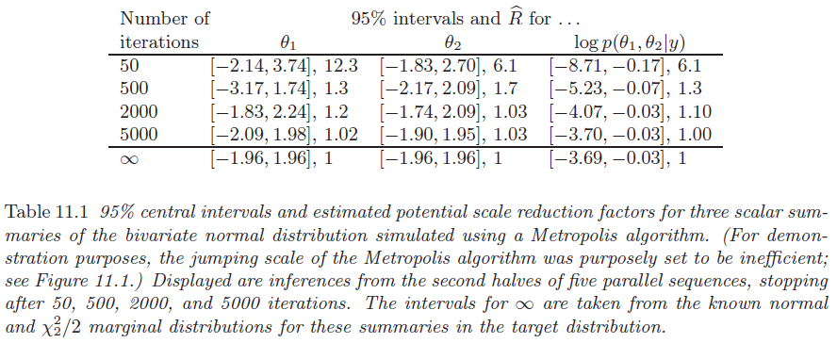

Slide 23

Assessing Convergence
We label the simulations as $ψ_{ij}$，$i=1,…,n$ ; $j=1,…,m$

Slide 24

Assessing Convergence
We label the simulations as $ψ_{ij}$，$i=1,…,n_{eff}$; $j=1,…,m$

Slide 25
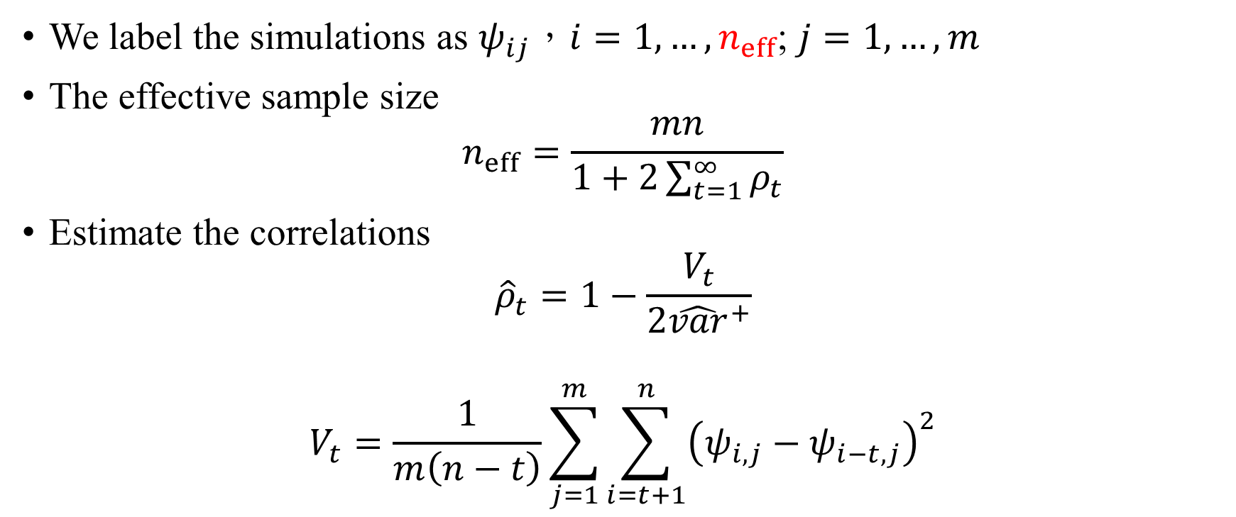
Assessing Convergence
We label the simulations as $ψ_{ij}$，$i=1,…,n_{eff}$; $j=1,…,m$
The effective sample size
$$n_{eff}=\frac{mn}{1+2\sum_{t=1}^{∞}{ρ_{t}}}$$
Estimate the correlations
$${\hat{ρ}}_{t}=1−\frac{V_{t}}{2{\hat{var}}^{+}}$$
$$V_{t}=\frac{1}{m\left(n−t\right)}\sum_{j=1}^{m}{\sum_{i=t+1}^{n}{{\left(ψ_{i,j}−ψ_{i−t,j}\right)}^{2}}}$$

Slide 26
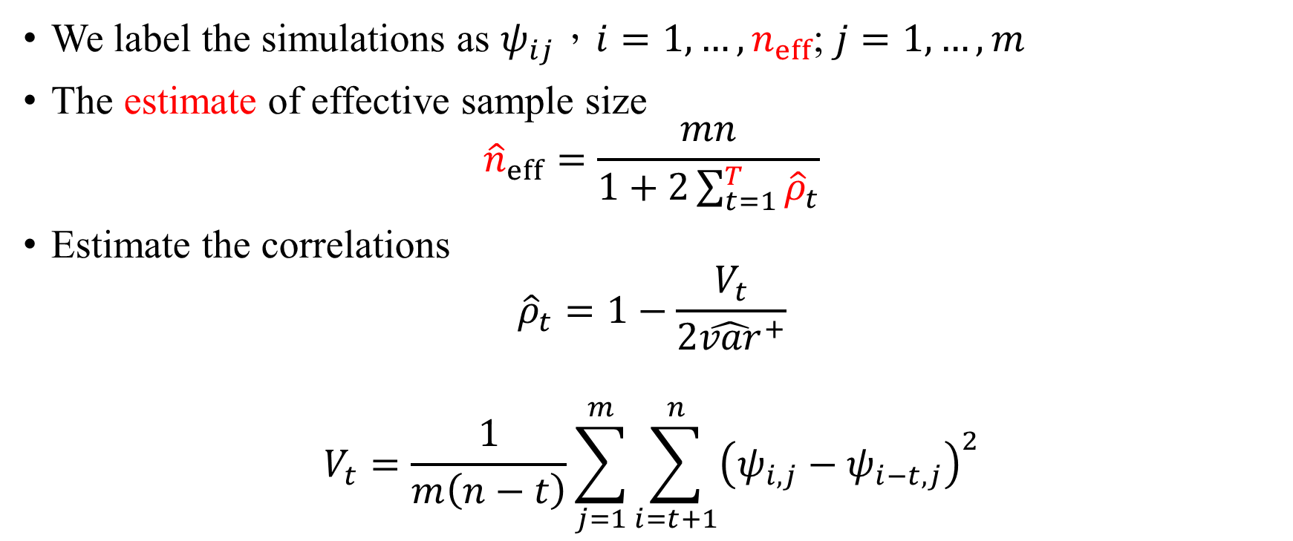
Assessing Convergence
We label the simulations as $ψ_{ij}$，$i=1,…,n_{eff}$; $j=1,…,m$
The estimate of effective sample size
$${\hat{n}}_{eff}=\frac{mn}{1+2\sum_{t=1}^{T}{{\hat{ρ}}_{t}}}$$
Estimate the correlations
$${\hat{ρ}}_{t}=1−\frac{V_{t}}{2{\hat{var}}^{+}}$$
$$V_{t}=\frac{1}{m\left(n−t\right)}\sum_{j=1}^{m}{\sum_{i=t+1}^{n}{{\left(ψ_{i,j}−ψ_{i−t,j}\right)}^{2}}}$$

Slide 27






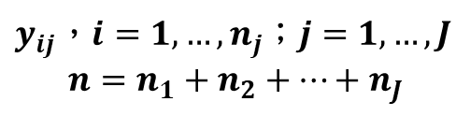











Example: hierarchical normal model
$$N\left(μ,τ^{2}\right)$$
$$N\left(θ_{1},σ^{2}\right)$$
$$N\left(θ_{2},σ^{2}\right)$$
$$N\left(θ_{3},σ^{2}\right)$$
$$N\left(θ_{4},σ^{2}\right)$$
$$N\left(θ_{5},σ^{2}\right)$$
$$N\left(θ_{j},σ^{2}\right)$$
$$⋯$$
$$N\left(θ_{J},σ^{2}\right)$$
$$y_{i1}$$
$$y_{i2}$$
$$y_{i3}$$
$$y_{i4}$$
$$y_{i5}$$
$$y_{ij}$$
$$⋯$$
$$y_{iJ}$$
Observations：
$y_{ij}$，$i=1,…,n_{j}$；$j=1,…,J$
$$n=n_{1}+n_{2}+⋯+n_{J}$$

Slide 28
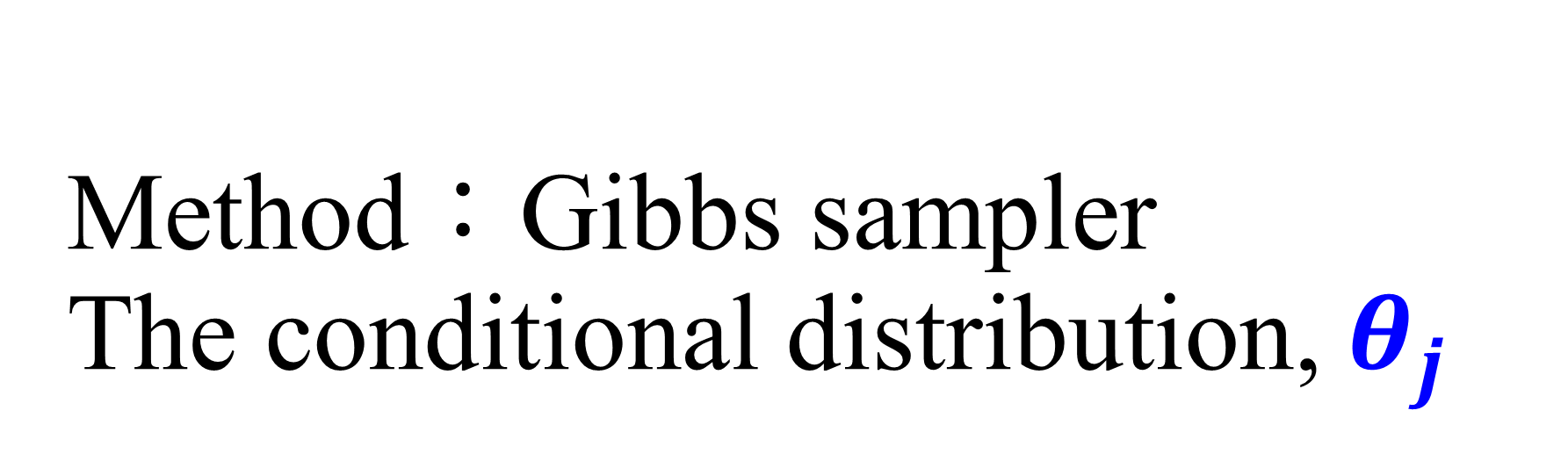
Method：Gibbs sampler The conditional distribution, $θ_{j}$

Slide 29

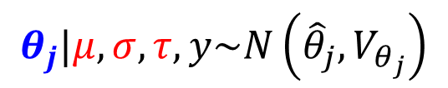

Example: hierarchical normal model
$$N\left(μ,τ^{2}\right)$$
$$N\left(θ_{1},σ^{2}\right)$$
$$N\left(θ_{2},σ^{2}\right)$$
$$N\left(θ_{3},σ^{2}\right)$$
$$N\left(θ_{4},σ^{2}\right)$$
$$N\left(θ_{5},σ^{2}\right)$$
$$N\left(θ_{j},σ^{2}\right)$$
$$⋯$$
$$N\left(θ_{J},σ^{2}\right)$$
$$y_{i1}$$
$$y_{i2}$$
$$y_{i3}$$
$$y_{i4}$$
$$y_{i5}$$
$$y_{ij}$$
$$⋯$$
$$y_{iJ}$$
$$i=1,…,n_{j}$$
$$θ_{j}|μ,σ,τ,y\sim N\left({\hat{θ}}_{j},V_{θ_{j}}\right)$$

Slide 30

$$θ_{j}|μ,σ,τ,y\sim N\left({\hat{θ}}_{j},V_{θ_{j}}\right)$$
$${\hat{θ}}_{j}=\frac{\frac{1}{τ^{2}}μ+\frac{n_{j}}{σ^{2}}{\overline{y}}_{∙j}}{\frac{1}{τ^{2}}+\frac{n_{j}}{σ^{2}}}$$
$$V_{θ_{j}}=\frac{1}{\frac{1}{τ^{2}}+\frac{n_{j}}{σ^{2}}}$$

Slide 31
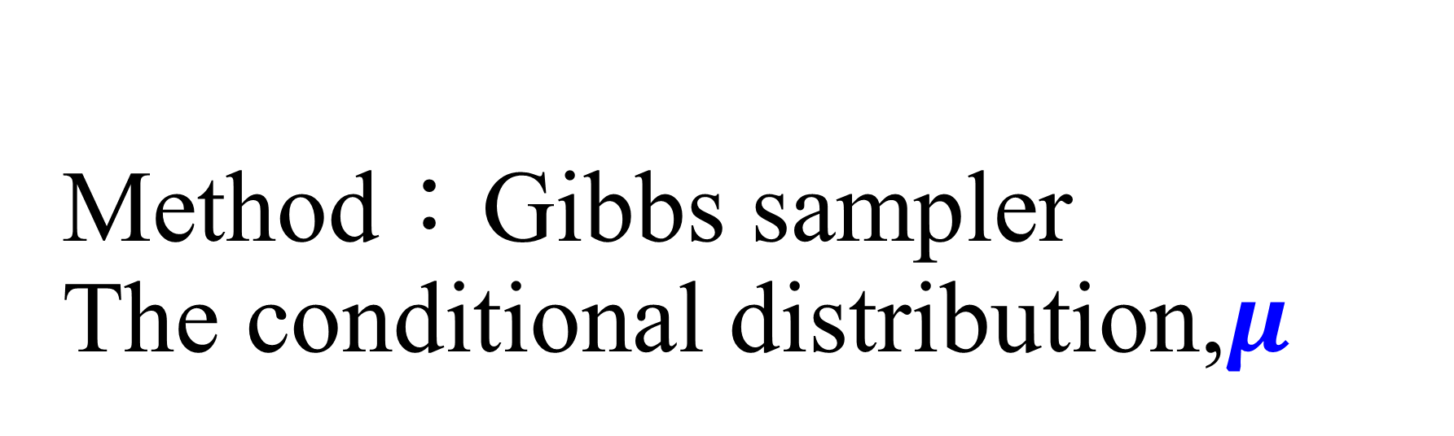
Method：Gibbs sampler The conditional distribution,$μ$

Slide 32
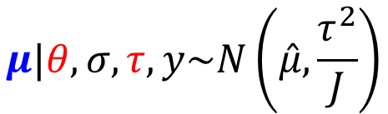

Example: hierarchical normal model
$$N\left(μ,τ^{2}\right)$$
$$N\left(θ_{1},σ^{2}\right)$$
$$N\left(θ_{2},σ^{2}\right)$$
$$N\left(θ_{3},σ^{2}\right)$$
$$N\left(θ_{4},σ^{2}\right)$$
$$N\left(θ_{5},σ^{2}\right)$$
$$N\left(θ_{j},σ^{2}\right)$$
$$⋯$$
$$N\left(θ_{J},σ^{2}\right)$$
$$y_{i1}$$
$$y_{i2}$$
$$y_{i3}$$
$$y_{i4}$$
$$y_{i5}$$
$$y_{ij}$$
$$⋯$$
$$y_{iJ}$$
$$μ|θ,σ,τ,y\sim N\left(\hat{μ},\frac{τ^{2}}{J}\right)$$

Slide 33

$$μ|θ,σ,τ,y\sim N\left(\hat{μ},\frac{τ^{2}}{J}\right)$$
$$\hat{μ}=\frac{1}{J}\sum_{j=1}^{J}{θ_{j}}$$

Slide 34
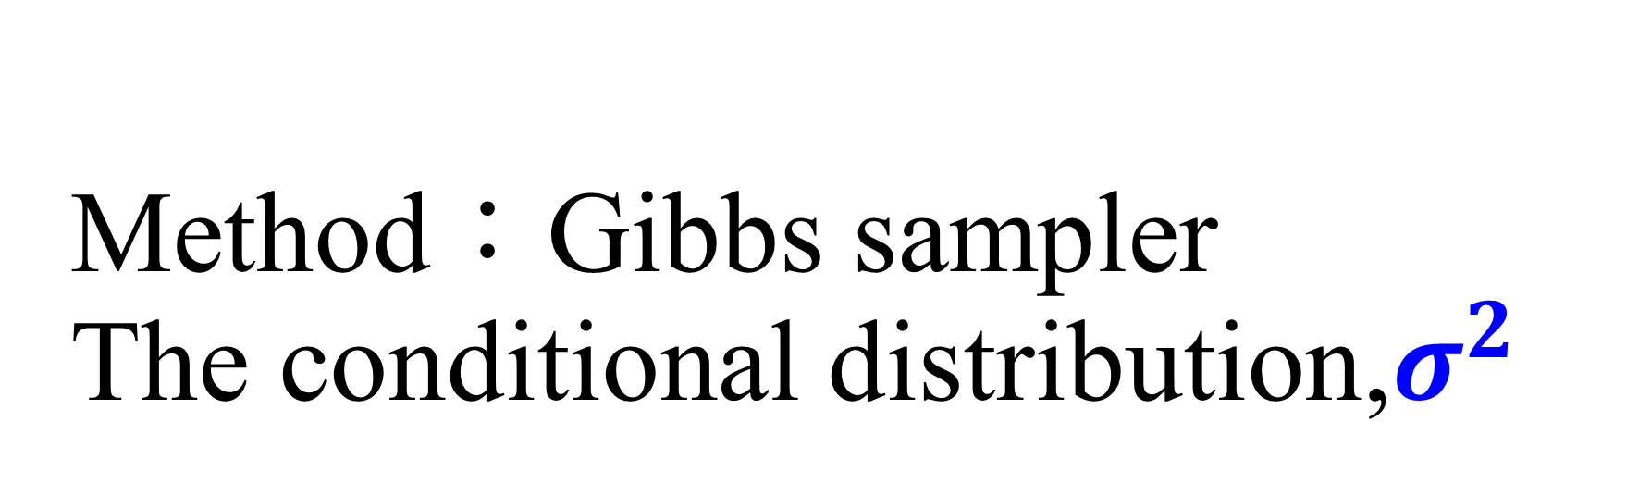
Method：Gibbs sampler The conditional distribution,$σ^{2}$

Slide 35








Example: hierarchical normal model
$$N\left(μ,τ^{2}\right)$$
$$σ^{2}|θ,μ,τ,y\sim Inv−χ^{2}\left(n,{\hat{σ}}^{2}\right)$$
$$N\left(θ_{1},σ^{2}\right)$$
$$N\left(θ_{2},σ^{2}\right)$$
$$N\left(θ_{3},σ^{2}\right)$$
$$N\left(θ_{4},σ^{2}\right)$$
$$N\left(θ_{5},σ^{2}\right)$$
$$N\left(θ_{j},σ^{2}\right)$$
$$⋯$$
$$N\left(θ_{J},σ^{2}\right)$$
$$y_{i1}$$
$$y_{i2}$$
$$y_{i3}$$
$$y_{i4}$$
$$y_{i5}$$
$$y_{ij}$$
$$⋯$$
$$y_{iJ}$$
Observations：
$y_{ij}$，$i=1,…,n_{j}$；$j=1,…,J$
$$n=n_{1}+n_{2}+⋯+n_{J}$$

Slide 36

$$σ^{2}|θ,μ,τ,y\sim Inv−χ^{2}\left(n,{\hat{σ}}^{2}\right)$$
$${\hat{σ}}^{2}=\frac{1}{n}\sum_{j=1}^{J}{\sum_{i=1}^{n_{j}}{{\left(y_{ij}−θ_{j}\right)}^{2}}}$$

Slide 37
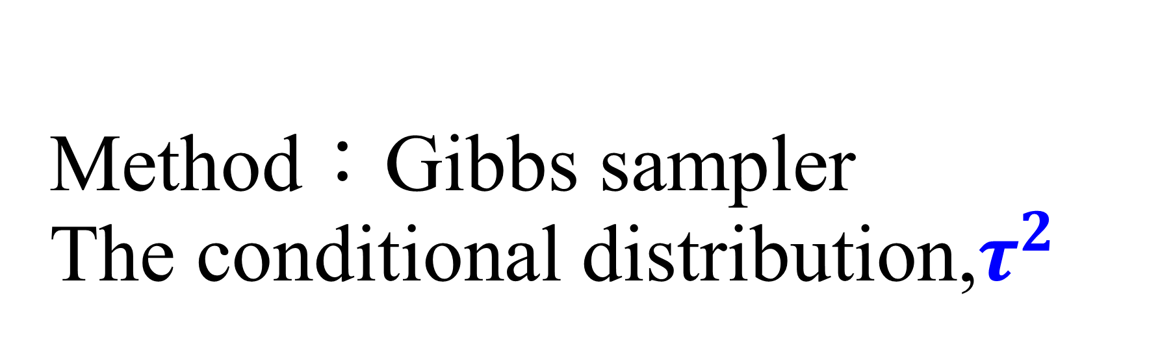
Method：Gibbs sampler The conditional distribution,$τ^{2}$

Slide 38


Example: hierarchical normal model
$$N\left(μ,τ^{2}\right)$$
$$N\left(θ_{1},σ^{2}\right)$$
$$N\left(θ_{2},σ^{2}\right)$$
$$N\left(θ_{3},σ^{2}\right)$$
$$N\left(θ_{4},σ^{2}\right)$$
$$N\left(θ_{5},σ^{2}\right)$$
$$N\left(θ_{j},σ^{2}\right)$$
$$⋯$$
$$N\left(θ_{J},σ^{2}\right)$$
$$y_{i1}$$
$$y_{i2}$$
$$y_{i3}$$
$$y_{i4}$$
$$y_{i5}$$
$$y_{ij}$$
$$⋯$$
$$y_{iJ}$$
$$τ^{2}|θ,μ,σ,y\sim Inv−χ^{2}\left(J−1,{\hat{τ}}^{2}\right)$$

Slide 39

$$τ^{2}|θ,μ,σ,y\sim Inv−χ^{2}\left(J−1,{\hat{τ}}^{2}\right)$$
$${\hat{τ}}^{2}=\frac{1}{J−1}\sum_{j=1}^{J}{{\left(θ_{j}−μ\right)}^{2}}$$

Slide 40
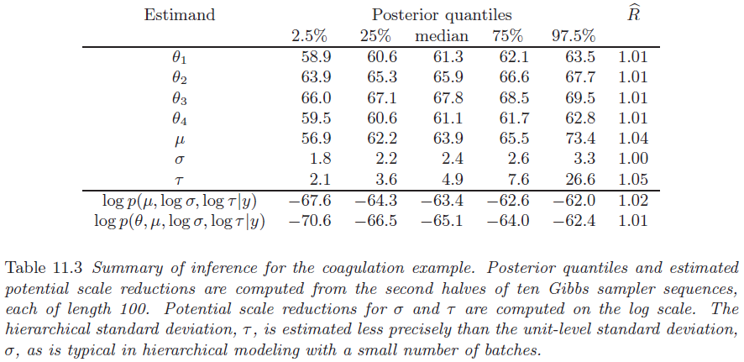

Slide 41


~元旦快樂~

